Slide 1
Data Analytics Bootcamp Project 1 Explanatory data analysis of life-expectancy based on health and development indicators per region
Group 1:
Gwendoline Grenu
Peter Lehel
Temitope Ajose-Adeogun
Farheen Oomatia

Slide 2
Table of Content
Aim of the project
Comparison of GDP, life expectancy (including population) & adult mortality across the entire dataset – Temi
Overview of GDP data for Asia, Europe and Africa – Peter
Data on diseases analysed for Asia & Africa– Gwen
Life expectancy in the American regions – Farheen
Limitations and Conclusion

Slide 3
Aim of the project
Dataset overview – which indicators are we looking at
Overview of life expectancy change over a decade
Correlation of GDP, life expectancy and health factors for selected regions
Life expectancy comparisons within each continent

Slide 4
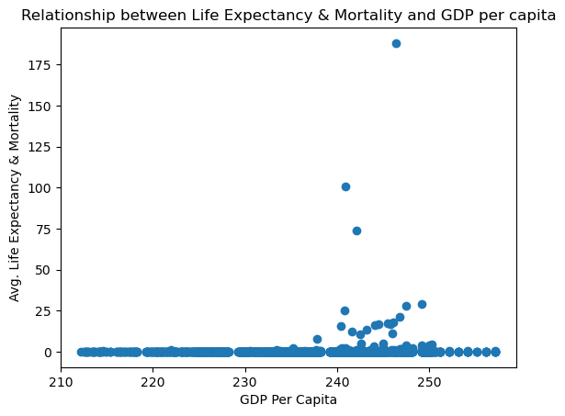
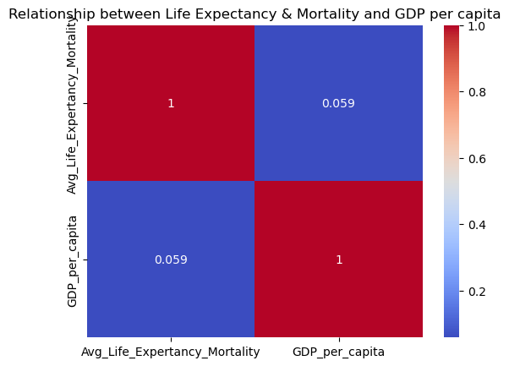

Slide 5
Peter's part

Slide 6
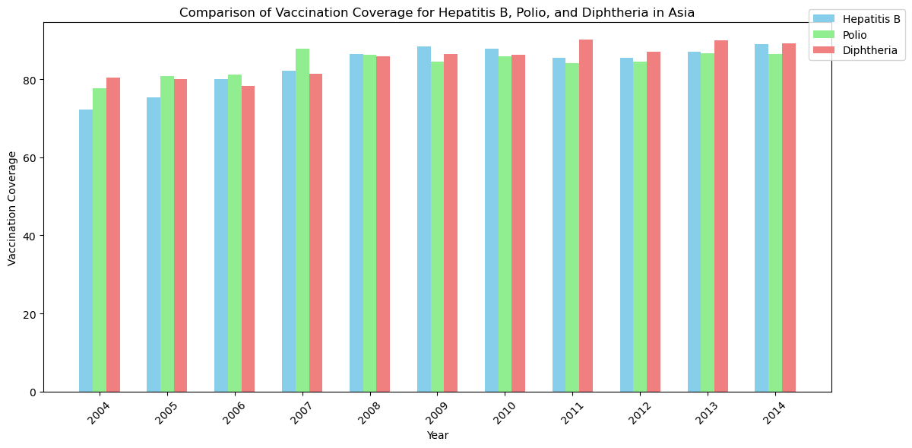
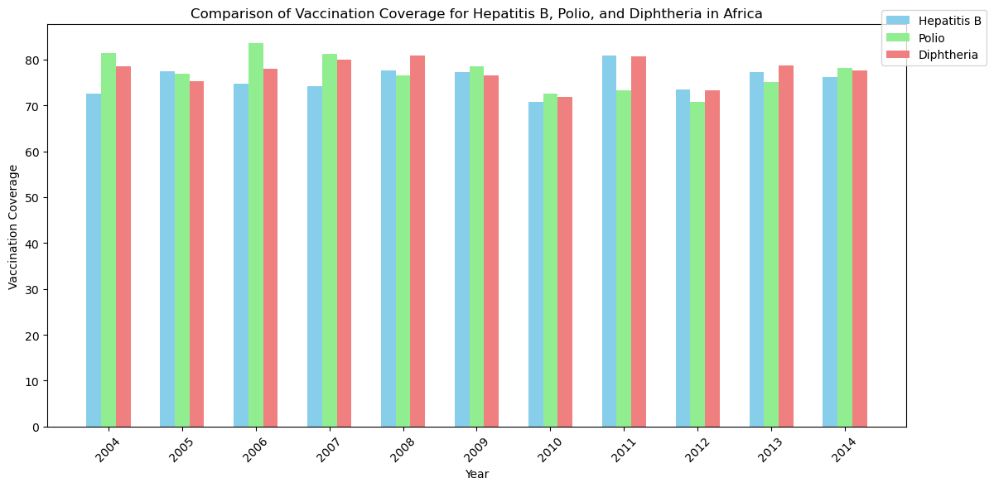
Comparison of vaccination coverage for Hepatitis B, Polio and Diphtheria for Asia and Africa

Slide 7
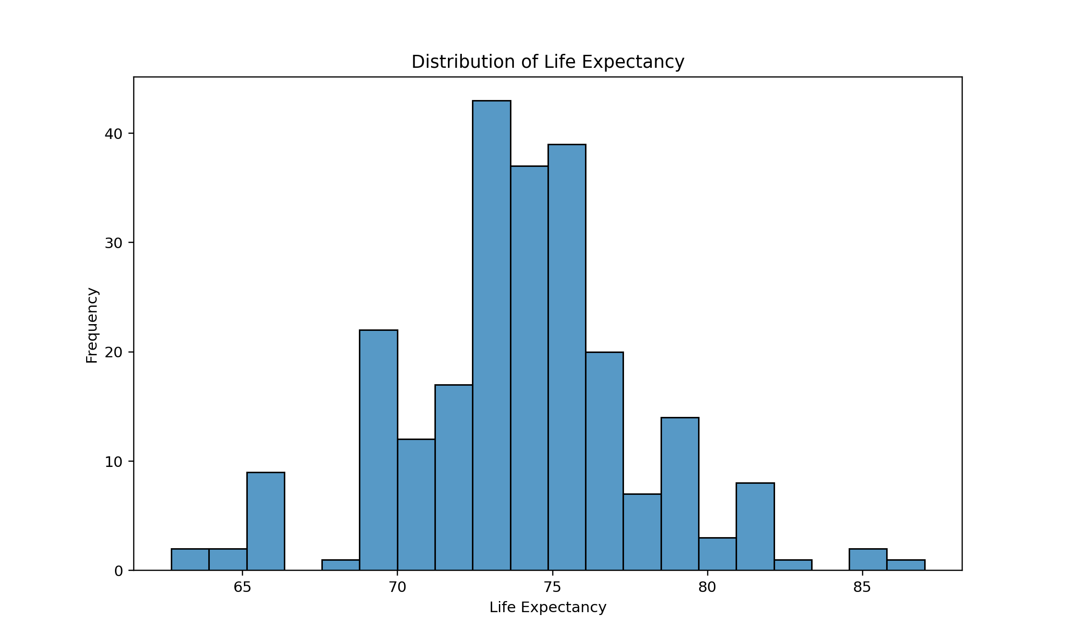
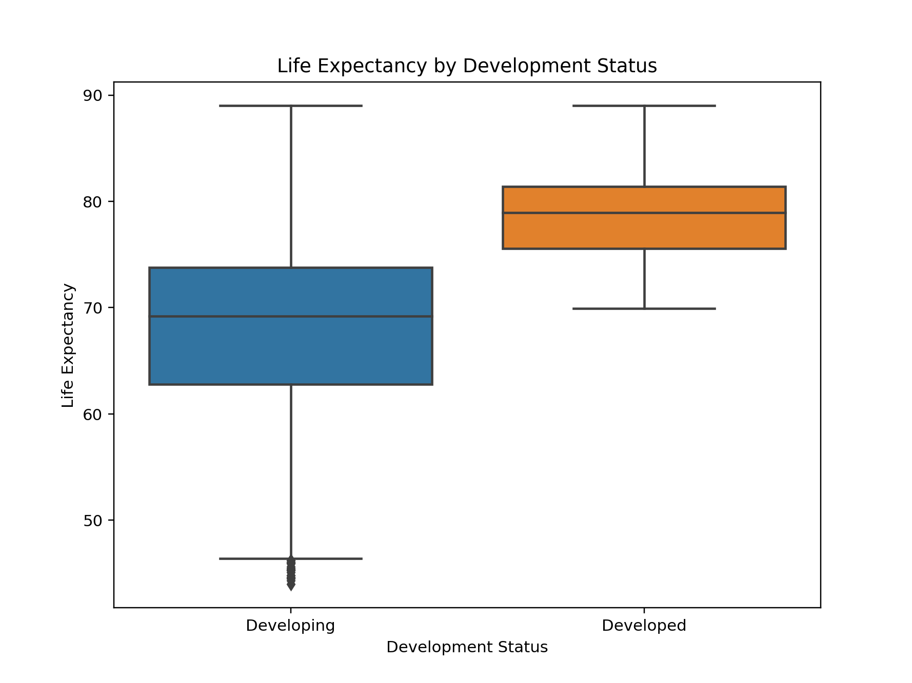
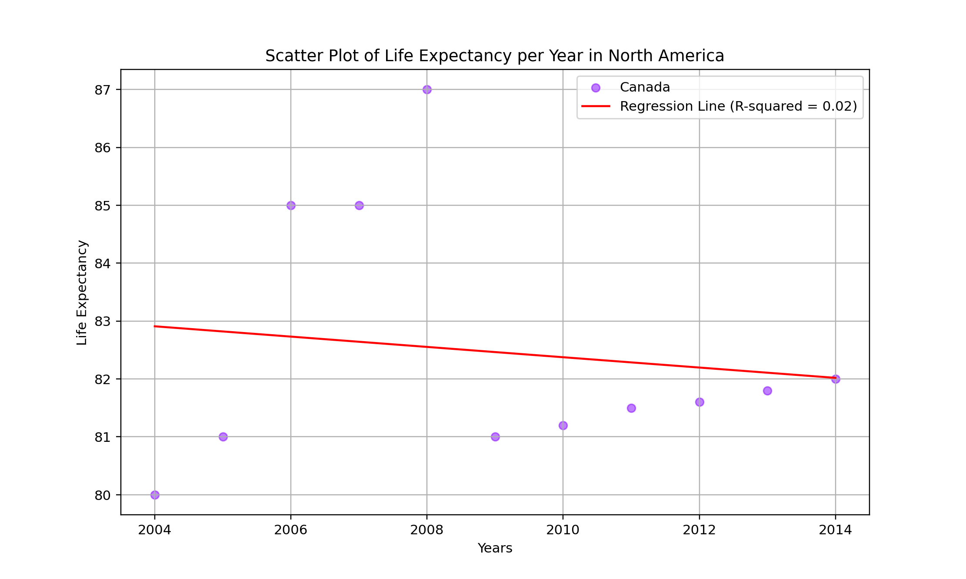
Life expectancy overview across the Caribbean, North, Central and South America 1. Life expectancy is around mostly at around 71-76 years 2. As a general trend, across all countries in the Caribbean, Central and South America, the life expectancy rose between 2004 and 2014. Only North America's regressions line shows a decline. - only Canada - unexplained spikes in LE skewed the graph
3. Life expectancy overview across developing and developed countries -> developing countries show a wider distribution of LE compared with developed countries
4. More outliers probably due to infant death

Slide 8
Limitations and Conclusion
Missing data from some countries
Missing USA from North America
Some indicators were not analysed due to loss of resource
Dataset accuracy - eg. Country status not as expected
Reliability of source
Political and envrionmental factors missing which might explain unspected spikes or drops in data
Resources:
https://www.kaggle.com/datasets/arunjangir245/life-expectancy-data

Slide 9


